Slide 1

MapReduce Framework

Slide 2
1.Create a file in Local File system (Vi Editor)
2.Transfer from LFS TO hdfs
(Hdfs dfs - put

Slide 3
Processing
Storage
HDFS
Master :NameNode
Slave : DataNode
Distributed Storage
Processing
Hadoop Generation 1
Master :Job Tracker
Slave :Task Tracker
Hadoop Generation 2
Master :Resource Manager
Slave :Node Manager
Why do we store the data ? We want to process this data and get value out of it

Slide 4
Master /Slave in HG1,2
Master
HG1
Job Tracker
HG2
Resource Manager
Slave
HG1
Task Tracker
HG2
Node Manager
Slave
HG1
Task Tracker
HG2
Node Manager
Slave
HG1
Task Tracker
HG2
Node Manager

Slide 5
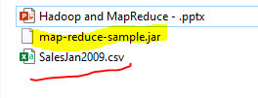
HG1
Processing in Hadoop Generation 1
Hadoop jar Jar FileName ClassName InputFilePath OutputFilePath
Jar ?Java program
I am going to transfer the logic to the machine which my block is available. That logic is basically is jar file
We are going to write a program in java and compile it to jar file
Any time you want to process any data you need to write the corresponding java program

Slide 6
Java is a program independent language .why?
Java :Platform Independent
Alex
Unix
Pedram
Java
JVM
Java Compiler
Java File
Bytecode
Sara
Windows
JVM
Notes:
Pedram is not bothered where the program is running (Using Unix or windows)
What JVM is going to do ? read the Bytecode and covert to machine level code which will be understandable by your OS (Unix or Windows)

Slide 7
HG1
Processing in Hadoop Generation 1
Hadoop jar Jar FileName ClassName InputFilePath OutputFilePath
Local HDFS
Jar File
InputFilePath
OutputFilePath
There are three files available here .

Slide 8
InputFilePath is available in HDFS
Divide and rule Parallel Processing Distributed computation
128MB
B1
B1
B2
B3
Abc.txt
300MB
L
L
L
128MB
B2
44 MB
B3
No Update possible in Hadoop
Add some file
Drop some file
WORM
Write once and Read /Process Multiple times
Data Blocks
Block size :128
InputFilePath is available in HDFS to make sure you can process parallelly .
If the file is available locally then its one file then how we can use it multiple time in the distributed computing manner

Slide 9
HG1- InputFilePath
Processing in Hadoop Generation 1
Hadoop jar Jar FileName ClassName InputFilePath OutputFilePath
Local HDFS
Jar File
InputFilePath X Y
OutputFilePath
There are three files available here .

Slide 10
OutputFilePath
Processing in Hadoop Generation 1
Hadoop jar Jar FileName ClassName InputFilePath OutputFilePath
Local HDFS
Jar File
InputFilePath X Y
OutputFilePath X y
Notes:
OutPutFilePath :Your OutPutFilePath is critical because the file has some meaning full information and that meaningful information you extracted from your data you would like to store in HDFS because that data will replicate and give you high availability

Slide 11
Jar File
Switch
Switch
Switch
R1N1
R2N5
B1
B1
Abc.txt
300MB
B2
B1
B1
B2
B3
B3
B2
Data Blocks
Block size :128
B3
R3N12
I need to process B1,B2,B3 .My B1 is available in R1N1,R1N2,R2N6 .Do we know in advance which B1 get process ? No ,we do not know
It can process in either B1 ,or B2 or B3.In Runtime your Jar file will be transfer to those machine. If you make it available to HDFS there is no point of doing that.
Notes:
So you make it available in local file system and at run time it is getting transferred in to the machine which the data is processing is going to happen(One of these three)

Slide 12
Jar File
Processing in Hadoop Generation 1
Hadoop jar Jar FileName ClassName InputFilePath OutputFilePath
Local HDFS
Jar File Y X
InputFilePath X Y
OutputFilePath X Y

Slide 13
Master /Slave in HG1,2
Master
HG1
Job Tracker
HG2
Resource Manager
Slave
HG1
Task Tracker
HG2
Node Manager
Slave
HG1
Task Tracker
HG2
Node Manager
Slave
HG1
Task Tracker
HG2
Node Manager
When you want to process the data you can log on to any machine .
Notes:
You will be firing these command (Hadoop jar Jar FileName ClassName InputFilePath OutputFilePath).We select one machine (Either Master or Slave)

Slide 14
Hadoop
Local HDFS
Jar File Y X
InputFilePath X Y
OutputFilePath X Y
Processing in Hadoop Generation 1
Hadoop jar Jar FileName ClassName InputFilePath OutputFilePath
Machine
Node
Client
Master
Job Tracker
Job ID
Job Queue
Our Job
/JOB ID (folder)
Jar File
InputFilePath
OutputFilePath
HDFS Location
Notes:
We log on to either Master or slave and from there we run the command .Who will be our first contact ? Master ?)
NameNode is not taking the processing .That was for Storage
As a client this Machine will contact Master which running Job Tracker and says I want to process this file (InputFilePath) with this logic (Jar FileName ClassName ) and save it (OutputFilePath)
Job Tracker might not be available as its doing other Jobs so it will maintain it in Job Queue. There are some Jobs already running .(The forth job is our job).
It may takes time but it will start .How it will acknowledge back by submitting Job ID then client Machine go to HDFS location and create a folder with the name of Job ID and /JOB ID and it will put the following files: Jar ,FileInputFilePath ,OutputFilePath.(Client Machine is doing that)
)

Slide 15
Hadoop
Local HDFS
Jar File Y X
InputFilePath X Y
OutputFilePath X Y
Processing in Hadoop Generation 1
Hadoop jar Jar FileName ClassName InputFilePath OutputFilePath
Machine
Node
Client
Master
Job Tracker
Job ID
Job Queue
Our Job
/JOB ID
Jar File
InputFilePath
OutputFilePath
HDFS Location
Notes:
Job Tracker is waiting to get some resource become free and Job Tracker is in the good position to get involve with your Job .It will go to HDFS location and search for Job ID from top to bottom
And it will find it . It will come to know about Jar file , FileInputFilePath ,OutputFilePath.
You may Waite some time for your job to start then only it starts .
Job Tracker will process InputFilePath with the help of this logic (“Jar File” ) and this is where the out put file made available (“OutputFilePath”)
Job tracker wants to know more information for “InputFilePath “ .From where it gets more information ?

Slide 16
Job tracker wants to know more information for “InputFilePath “ .From where it gets more information ?
Local HDFS
Jar File Y X
InputFilePath X Y
OutputFilePath X Y
Processing in Hadoop Generation 1
Hadoop jar Jar FileName ClassName InputFilePath OutputFilePath
Machine
Node
Client
Master
Job Tracker
Master
Name Node
Batch /abc.txt
B1,B2,B3
B1:3,2,6
B2:4,5,7
B3:11,21,9
Job ID
Job Queue
Our Job
/JOBID
Jar File
InputFilePath
OutputFilePath
HDFS Location
Notes:
Job tracker wants to know more information for “InputFilePath “ .From where it gets more information ?
Who contains the Meta data information ? WHERE IS MY Meta Data information available ? NameNode
Because the NameNode is the one maintain the Meta Data It says
Your processing Master which is Job Tracker will going to keep in touch with Master of Storage (NameNode) and what it will do ?It says I need to meta Data for this particular file
This NameNode will return the complete information of Meta Data to Job Tracker
The responsibility of NameNode is to provide the Meta Data information and noting more than that. It is not going to provide anything rather than Meta Data.

Slide 17
Should I process B1 in all three machine or one is enough ?
Local HDFS
Jar File Y X
InputFilePath X Y
OutputFilePath X Y
Processing in Hadoop Generation 1
Hadoop jar Jar FileName ClassName InputFilePath OutputFilePath
Machine
Node
Client
Master
Job Tracker
Master
Name Node
Batch /abc.txt
B1,B2,B3
B1:6,3,78
B2:7 ,5,4
B3:11,21,9
Job ID
Job Queue
Our Job
/JOBID
Jar File
InputFilePath
OutputFilePath
HDFS Location
Notes:
Should I process B1 in all three machine or one is enough ? Only in One Machine
The processing for one block will happen in one machine then how the selection of machine will be done ?selection critical

Slide 18
Who is taking this decision ?
Local HDFS
Jar File Y X
InputFilePath X Y
OutputFilePath X Y
Processing in Hadoop Generation 1
Hadoop jar Jar FileName ClassName InputFilePath OutputFilePath
Machine
Node
Client
Master
Job Tracker
Master
Name Node
Batch /abc.txt
B1,B2,B3
B1:3,7,21
B2:4,5,7
B3:11,21,9
Job ID
/JOBID
Jar File
InputFilePath
OutputFilePath
M3
M7
M21
B1
B2
B3
HDFS Location
Notes:
Job tracker is going to decide it
Job tracker has decided to process B1 on machine 3 ,B2 on M7 and B3 on M21 based on the concept of data locality

Slide 19
What Next ?
Local HDFS
Jar File Y X
InputFilePath X Y
OutputFilePath X Y
Processing in Hadoop Generation 1
Hadoop jar Jar FileName ClassName InputFilePath OutputFilePath
Machine
Node
Client
Master
Job Tracker
Master
Name Node
Batch /abc.txt
B1,B2,B3
B1:3,2,6
B2:4,5,7
B3:11,21,9
Job ID
/JOBID
Jar File
InputFilePath
OutputFilePath
M3
M7
M21
B1
B2
B3
Jar file
HDFS Location
Notes:
The Data is available now
Now Job tracker will take the Jar file and put it in the Machines which has the data after the selection process is complete
You have your data and logic is available
What else is required ?

Slide 20
What else is required ?
Local HDFS
Jar File Y X
InputFilePath X Y
OutputFilePath X Y
Processing in Hadoop Generation 1
Hadoop jar Jar FileName ClassName InputFilePath OutputFilePath
Machine
Node
Client
Master
Job Tracker
Master
Name Node
Batch /abc.txt
B1,B2,B3
B1:3,2,6
B2:4,5,7
B3:11,21,9
Job ID
TT
Task Tracker
TT
TT
/JOBID
Jar File
InputFilePath
OutputFilePath
M3
M7
M21
B1
B2
B3
HDFS Location
Notes:
What else is required ?
We do require some ram and some processing capacity to process
We mentioned before we are going to make of the local process capacity (Hard disk ,ram ,CPU)
So the process is running in all three slave machine and it called Task Tracker

Slide 21
Task Tracker and Job Tracker (TT)
Local HDFS
Jar File Y X
InputFilePath X Y
OutputFilePath X Y
Processing in Hadoop Generation 1
Hadoop jar Jar FileName ClassName InputFilePath OutputFilePath
Machine
Node
Client
Master
Job Tracker
Master
Name Node
Batch /abc.txt
B1,B2,B3
B1:3,2,6
B2:4,5,7
B3:11,21,9
Job ID
TT
TT
TT
/JOBID
Jar File
InputFilePath
OutputFilePath
M3
M7
M21
B1
B2
B3
HDFS Location
Notes:
Job tracker will connect to all Task Tracker
Job tracker and ask them I want to process this block to your machine with the help of Logic which require some capacity which is a combination of ram and cpu
I am asking for JVM

Slide 22
Task Tracker and Job Tracker (TT)
Local HDFS
Jar File Y X
InputFilePath X Y
OutputFilePath X Y
Processing in Hadoop Generation 1
Hadoop jar Jar FileName ClassName InputFilePath OutputFilePath
Machine
Node
Client
Master
Job Tracker
Master
Name Node
Batch /abc.txt
B1,B2,B3
B1:3,2,6
B2:4,5,7
B3:11,21,9
Job ID
TT
TT
TT
/JOBID
Jar File
InputFilePath
OutputFilePath
M3
M7
M21
B1
B2
B3
CPU
RAM
CPU
RAM
CPU
RAM
HDFS Location
Notes:
Job tracker will connect to all Task Tracker
Job tracker and ask them I want to process this block to your machine with the help of Logic which require some capacity which is a combination of ram and cpu
I am asking for JVM
Note :Any of the processing capacity made available for any of the job processing that task will be done by TT at the request of JT because JT is basically the one who requested TT to do that to locate some of the resource capacity for this particular processing

Slide 23
Container
Local HDFS
Jar File Y X
InputFilePath X Y
OutputFilePath X Y
Processing in Hadoop Generation 1
Hadoop jar Jar FileName ClassName InputFilePath OutputFilePath
Machine
Node
Client
Master
Job Tracker
Master
Name Node
Batch /abc.txt
B1,B2,B3
B1:3,2,6
B2:4,5,7
B3:11,21,9
Job ID
TT
TT
TT
/JOBID
Jar File
InputFilePath
OutputFilePath
M3
M7
M21
B1
B2
B3
Container
Container
Container
HDFS Location
Notes:
Job tracker will connect to all Task Tracker
Job tracker and ask them I want to process this block to your machine with the help of Logic wich require some capacity which is a combination of ram and cpu
I am asking for JVM
Note :Any of the processing capacity made available for any of the job processing that task will be done by TT at the request of JT because JT is basically the one who requested TT to do that to locate some of the resource capacity for this particular processing
Container is the JVM process which has HAS SOME AMOUT OF cpu ,and RAM

Slide 24
Output
Local HDFS
Jar File Y X
InputFilePath X Y
OutputFilePath X Y
Processing in Hadoop Generation 1
Hadoop jar Jar FileName ClassName InputFilePath OutputFilePath
Machine
Node
Client
Master
Job Tracker
Master
Name Node
Batch /abc.txt
B1,B2,B3
B1:3,2,6
B2:4,5,7
B3:11,21,9
Job ID
TT
TT
TT
/JOBID
Jar File
InputFilePath
OutputFilePath
M3
M7
M21
B1
B2
B3
Container
Container
Container
HDFS Location
Notes:
Now you have your logic available ,Your block available .your resource capacity available then what ?
You simply process your data using this process capacity and get your output

Slide 25
Is this my Ultimate output ?Output
Local HDFS
Jar File Y X
InputFilePath X Y
OutputFilePath X Y
Processing in Hadoop Generation 1
Hadoop jar Jar FileName ClassName InputFilePath OutputFilePath
Machine
Node
Client
Master
Job Tracker
Master
Name Node
Batch /abc.txt
B1,B2,B3
B1:3,2,6
B2:4,5,7
B3:11,21,9
Job ID
TT
TT
TT
/JOBID
Jar File
InputFilePath
OutputFilePath
M3
M7
M21
B1
B2
B3
Container
Container
Container
Jeff
Alex
Andy
HDFS Location
Notes:
No ,I have to combine this output.
I need to find out the person who has got the highest mark .(Alex)
Alex record is available in B2.You simply get to know who has got the highest mark in Block B2 itself.
If we talk about B1 here .When you processing B1 you can simply get to know who has got the highest mark there like Jeff .These are intermediate output .We need to make sure we combine these output. And find out ultimate output

Slide 26
What will be happen now ?
Local HDFS
Jar File Y X
InputFilePath X Y
OutputFilePath X Y
Processing in Hadoop Generation 1
Hadoop jar Jar FileName ClassName InputFilePath OutputFilePath
Machine
Node
Client
Master
Job Tracker
Master
Name Node
Batch /abc.txt
B1,B2,B3
B1:3,2,6
B2:4,5,7
B3:11,21,9
Job ID
TT
TT
TT
/JOBID
Jar File
InputFilePath
OutputFilePath
M3
M7
M21
B1
B2
B3
Container
Container
Container
Jeff
Alex
Andy
HDFS Location
TT
C
Notes:
What will be happen now ?
These are our intermediate output and we need these outputs so we are able to find the ultimate output.
So one more machine will be selected and it will get the intermediate data will be collected on top of these machine.
To process this out put we transfer the logic to this machine and this machine has the task tracker running inside
What will happen JT will ask TT to allocate some resource to process this task. It will simply allocate the container
The selection of machine is done by job tracker base on data locality

Slide 27
My Ultimate Result
Machine
Node
Client
Master
Job Tracker
Master
Name Node
Batch /abc.txt
B1,B2,B3
B1:3,2,6
B2:4,5,7
B3:11,21,9
Job ID
TT
TT
TT
/JOBID
Jar File
InputFilePath
OutputFilePath
M3
M7
M21
B1
B2
B3
Container
Container
Container
Jeff
Alex
Andy
HDFS Location
TT
C
Alex
Write Anatomy
HDFS
My Ultimate data
Notes:
These data will be transferred from your local to HDFS
Which location it will be transferred ? The OutputFilePath which we already given in the command

Slide 28
MapReduce
Machine
Node
Client
Master
Job Tracker
Master
Name Node
Batch /abc.txt
B1,B2,B3
B1:3,2,6
B2:4,5,7
B3:11,21,9
Job ID
TT
TT
TT
/JOBID
Jar File
InputFilePath
OutputFilePath
M3
M7
M21
B1
B2
B3
M
M
M
Container
Container
Container
Jeff
Alex
Andy
HDFS Location
Sort and shuffle
M
R
MapReduce
TT
C
Alex
Write Anatomy
HDFS
My Ultimate data
Notes:
These logic called Mapper .we show that by M
The logic which is used at the end is reducer or R
The complete scenario called MapReduce
That’s work is done by an intermediate phase which is call sort and shuffle (These data is collected by different machine and it is made available by single machine)
It takes the output of all Mapper which are running in different machine and put it in one machine which reducer is going to run

Slide 29
What happen if something fails
Machine
Node
Client
Master
Job Tracker
Master
Name Node
Batch /abc.txt
B1,B2,B3
B1:3,2,6
B2:4,5,7
B3:11,21,9
Job ID
TT
TT
TT
/JOBID
Jar File
InputFilePath
OutputFilePath
M3
M7
M21
B1
B2
B3
M
M
M
Container
Container
Container
Jeff
Alex
Andy
HDFS Location
Sort and shuffle
M
R
MapReduce
TT
C
Alex
Write Anatomy
HDFS
My Ultimate data

Slide 30
Failure scenario
Mapper may fail (Mapper is your logic)
Two reason
Mapper may fail because of network issue
Because of your logic you written there .You are expect it an integer .You data is corrupted and you are getting string. (so you are getting something else
2.Reducer may fail
3.TT may fail
4.JT may fail

Slide 31
Mapper may fail
Machine
Node
Client
Master
Job Tracker
Master
Name Node
Batch /abc.txt
B1,B2,B3
B1:3,2,6
B2:4,5,7
B3:11,21,9
Job ID
TT
TT
TT
/JOBID
Jar File
InputFilePath
OutputFilePath
M3
M7
M21
B1
B2
B3
M
M
M
Container
Container
Container
Jeff
Alex
Andy
HDFS Location
Sort and shuffle
M
R
MapReduce
TT
C
Alex
Write Anatomy
HDFS
My Ultimate data
Notes:
What TT will do ? It will monitor and confirm it with JT that this Mapper which is running in my machine is failed. JT will ask TT ok no issue please run it again
It means 90% of the task is done and then the issue appear. so TT has to start again.
Please note the mappers do not have any relation with process of other mapper . The failure of Mapper will not affect another Mapper .The other Mapper will not know that one of the Mapper has failed.
They are completely isolated from others
The reduce can not start till all the Mapper are completed and sent to the single machine .
M at M3 has issue but M at M7 and M21 have finished .It Delays the Job processing
So M at M3 will increase the time of processing .
How many times it ask to run again ? 4 times so it has to do the same procedure as I mentioned above .After four times Job will be terminated and error message will be displayed in your terminal . You have to find out the error
Resolve it and run it again

Slide 32
Failure scenario
Mapper may fail (Mapper is your logic)
Two reason
Mapper may fail because of network issue
Because of your logic you written there .You are expect it an integer .You data is corrupted and you are getting string. (so you are getting something else
2.Reducer may fail
Two reason
Reducer may fail because of network issue
Because of your logic you written there .You are expect it an integer .You data is corrupted and you are getting string. (so you are getting something else
3.TT may fail
4.JT may fail

Slide 33
Reducer fail
Machine
Node
Client
Master
Job Tracker
Master
Name Node
Batch /abc.txt
B1,B2,B3
B1:3,2,6
B2:4,5,7
B3:11,21,9
Job ID
TT
TT
TT
/JOBID
Jar File
InputFilePath
OutputFilePath
M3
M7
M21
B1
B2
B3
M
M
M
Container
Container
Container
Jeff
Alex
Andy
HDFS Location
Sort and shuffle
M
R
MapReduce
TT
C
Alex
Write Anatomy
HDFS
My Ultimate data
Notes:
What TT will do ? It will monitor and confirm it with JT that this Reducer which is running in my machine is failed. JT will ask TT ok no issue please run it again
It means 90% of the task is done and then the issue appear. so TT has to start again.
How many times it ask to run again ? 4 times so it has to do the same procedure as I mentioned above .After four times Job will be terminated and error message will be displayed in your console. You have to find out the error
Resolve it and run it again .

Slide 34
Failure scenario
Mapper may fail (Mapper is your logic)
Two reason
Mapper may fail because of network issue
Because of your logic you written there .You are expect it an integer .You data is corrupted and you are getting string. (so you are getting something else
2.Reducer may fail
Two reason
Reducer may fail because of network issue
Because of your logic you written there .You are expect it an integer .You data is corrupted and you are getting string. (so you are getting something else
3.TT may fail
4.JT may fail

Slide 35
TT fail
Machine
Node
Client
Master
Job Tracker
Master
Name Node
Batch /abc.txt
B1,B2,B3
B1:3,2,6
B2:4,5,7
B3:11,21,9
Job ID
TT
TT
TT
/JOBID
Jar File
InputFilePath
OutputFilePath
M3
M7
M21
B1
B2
B3
M
M
M
Container
Container
Container
Jeff
Alex
Andy
HDFS Location
Sort and shuffle
R
MapReduce
TT
C
Alex
Write Anatomy
HDFS
My Ultimate data
Notes:
We learned that slave and master are sending heart beat .If TT fails there will be no heartbeat receive by JT and after fixed time it assume that TT is failed.TT failure I same as Machine Failure. For example second TT fails
It means you could not process B2 now. If you are not able to process B2 so what will happen ? JT has connected with Name Node which has the Metadata .JT can decide on which machine your B2 data can be proceed now based on locality concept.
It can be M4 ,M5 .If its not possible then it will start in another machine.
So mapper has to start again in that machine. It is not a failure of your job .The process of that particular block is going to happen again in another machine.

Slide 36
Failure scenario
Mapper may fail (Mapper is your logic)
Two reason
Mapper may fail because of network issue
Because of your logic you written there .You are expect it an integer .You data is corrupted and you are getting string. (so you are getting something else
2.Reducer may fail
Two reason
Reducer may fail because of network issue
Because of your logic you written there .You are expect it an integer .You data is corrupted and you are getting string. (so you are getting something else
3.TT may fail
4.JT may fail

Slide 37
JT fail
Machine
Node
Client
Master
Job Tracker
Master
Name Node
Batch /abc.txt
B1,B2,B3
B1:3,2,6
B2:4,5,7
B3:11,21,9
Job ID
TT
TT
TT
/JOBID
Jar File
InputFilePath
OutputFilePath
M3
M7
M21
B1
B2
B3
M
M
M
Container
Container
Container
Jeff
Alex
Andy
HDFS Location
Sort and shuffle
R
MapReduce
TT
C
Alex
Write Anatomy
HDFS
My Ultimate data
Notes:
What will happen if JT fails ?JT is master of job process .If the master goes down then everything goes down. It will result to complete failure .In another word its single point of failure
All the jobs which are running at that point of time each and everything will come to stop
It means all the resources will be released and new jobs can not be run

Slide 38
HG1 Problem
JT
Capacity 20 Container
15 M
5 R
==============
Already Engaged 13 M
3 R
==============
Left out
2 M
2 R
============
JOB
3M
1R
capacity
You were not able to utilize your processing capacity to maximum
Notes:
Version 1 had many bug which was resolved in HG2
The resource capacity which was available to the machine basically you are lunching these container .Let me explain what happen to Hadoop generation 1 is ? If this is the total capacity available in one machine
what is done ?These capacity was equally divided. So same capacity is given to any Mapper or reducer
Assume that we have got 20 container .15 M and 5 R .These are fixed in advance .This is a problem in HG1.These container is going to work and Mapper or container.
2M is left but our job require 3 M so 2 will be assigned and one will be Waite.
2R is left and job require 1 reduce so in total 1 R will be left .
You were not able to utilize your processing capacity to maximum

Slide 39
HG2 Example
Pedram
CEO
Hadoop Project
Client A
Hadoop Project
Head (TOR)
Alex
Head (MON)
Sara
Head (USA)
Sam
Hadoop Project
Software Developer
Software Developer
Andrew(
Software Developer)
Software Developer
Software Developer
Software Developer
Software Developer
Software Developer
Software Developer
Software Developer
Software Developer
Software Developer
Software Developer
Software Developer
Software Developer
Software Developer
Software Developer
Software Developer
Notes:
Pedram is starting his business and he will involve most of the task after his business move forward he starts hiring more people to reduce his task.
Three development center
There is a project come to pedram and pedram assign it to Sara and Sara ask Andrew to do it .Andrew asks for more developer .In this case Pedram focus more on Business side (HG2) rather than doing everything by their own (HG1)

Slide 40
HG2
Processing in HG2
Hadoop jar jarfilename className InputFilePath OutputFilePath
Node
Client
Master
Resource Manager
Name Node
Batch /abc.txt
B1,B2,B3
B1:3,2,6
B2:4,5,7
B3:11,21,9
Job ID
/JOBID
Jar File
InputFilePath
OutputFilePath
NM(Sara)
AM
Notes:
We connect to one of the machine and run the command (Hadoop jar jarfilename className InputFilePath OutputFilePath”)
In HG2 our Master will be our resource manager .RM will maintain the jobs in the queue and it will ask for wait for some time because of the resource .It will sends the Job ID and it will be starts when the capacity is available. Client will create a folder in HDFS and put JOBID Jar File ,InputFilePath ,OutputFilePath
Once after some time when your resource manager can take your job ,it will find out for one machine which is free. So it reach out to Node Manager
It ask NM ( Sara) that you are free and ask NM to assign some of the resource capacity to do the job .so it will make some resource capacity available to Andrew
Resource master will outsource the job
AM will go to /JOBID and gets all the information .Then it gets in touch with Name Node (Master for storage part of it)
NameNode will respond with Meta Data information to AM.
NM :Node Manager
AM :Application Master ( )

Slide 41
HG2
Processing in HG2
Hadoop jar jarfilename className InputFilePath OutputFilePath
Node
Client
Master
Resource Manager
Name Node
Batch /abc.txt
B1,B2,B3
B1:6,3,78
B2:4,5,7
B3:11,21,9
Job ID
NM
NM
NM
/JOBID
Jar File
InputFilePath
OutputFilePath
NM
M78
M5
M21
B1
M
B2
M
B3
M
AM
C
C
C
Jeff
Jeff
Jeff
Notes:
AM based on the data locality concept it is going to find out I will process B1 on M78 B2 on M5 AND b3 ON m21
Each machine has their own NM
Your logic will be transferred to the machine which has been selected for processing
AM will keep in touch will all NM and ask to allocate resource
Then they will allocate the container
NM :Node Manager
AM :Application Master

Slide 42
HG2
Processing in HG2
Hadoop jar jarfilename className InputFilePath OutputFilePath
Node
Client
Master
Resource Manager
Name Node
Batch /abc.txt
B1,B2,B3
B1:6,3,78
B2:4,5,7
B3:11,21,9
Job ID
NM
NM
NM
NM
M78
M5
M21
/JOBID
Jar File
InputFilePath
OutputFilePath
B1
B2
B3
M
M
M
AM
C
C
C
Jeff
Alex
Bob
Sort and Shuffle
HDFS
C
NM
R
Alex
My Ultimate data
Notes:
NM :Node Manager
AM :Application Master (Sara)

Slide 43
Failure scenario
Mapper may fail (Mapper is your logic)
Two reason
Mapper may fail because of network issue
Because of your logic you written there .You are expect it an integer .You data is corrupted and you are getting string. (so you are getting something else
2.Reducer may fail
3.NM may fail
4.AM Failure
5.RM may fail

Slide 44
Mapper Fail
Processing in HG2
Hadoop jar jarfilename className InputFilePath OutputFilePath
Node
Client
Master
Resource Manager
Name Node
Batch /abc.txt
B1,B2,B3
B1:6,3,78
B2:4,5,7
B3:11,21,9
Job ID
NM
NM
NM
NM
M78
M5
M21
/JOBID
Jar File
InputFilePath
OutputFilePath
B1
B2
B3
M
M
M
AM
C
C
C
Jeff
Alex
Bob
Sort and Shuffle
HDFS
C
NM
R
Alex
My Ultimate data
Notes:
If Mapper fails the AM will ask NM to run it again .Your NM will run again and start from scratch. If M on M78 fails it will not affect other process.
It will increase the total time because they have to wait till all Mapper have done.so reducer can not starts
NM :Node Manager
AM :Application Master (Sara)

Slide 45
Failure scenario
Mapper may fail (Mapper is your logic)
Two reason
Mapper may fail because of network issue
Because of your logic you written there .You are expect it an integer .You data is corrupted and you are getting string. (so you are getting something else
2.Reducer may fail
Two reason
Reducer may fail because of network issue
Because of your logic you written there .You are expect it an integer .You data is corrupted and you are getting string. (so you are getting something else
3.NM may fail
4.AM Failure
5.RM may fail

Slide 46
Reducer Fail
Processing in HG2
Hadoop jar jarfilename className InputFilePath OutputFilePath
Node
Client
Master
Resource Manager
Name Node
Batch /abc.txt
B1,B2,B3
B1:6,3,78
B2:4,5,7
B3:11,21,9
Job ID
NM
NM
NM
NM
M78
M5
M21
/JOBID
Jar File
InputFilePath
OutputFilePath
B1
B2
B3
M
M
M
AM
C
C
C
Jeff
Alex
Bob
Sort and Shuffle
HDFS
C
NM
R
Alex
My Ultimate data
Notes:
If Reducer fails the AM will ask NM to run it again .Your NM will run again and start from scratch (4 times )
Same stuff as before

Slide 47
Failure scenario
Mapper may fail (Mapper is your logic)
Two reason
Mapper may fail because of network issue
Because of your logic you written there .You are expect it an integer .You data is corrupted and you are getting string. (so you are getting something else
2.Reducer may fail
Two reason
Reducer may fail because of network issue
Because of your logic you written there .You are expect it an integer .You data is corrupted and you are getting string. (so you are getting something else
3.NM may fail
4.AM Failure
5.RM may fail

Slide 48
NM Fail
Processing in HG2
Hadoop jar jarfilename className InputFilePath OutputFilePath
Node
Client
Master
Resource Manager
Name Node
Batch /abc.txt
B1,B2,B3
B1:6,3,78
B2:4,5,7
B3:11,21,9
Job ID
NM
NM
NM
NM
M78
M5
M21
/JOBID
Jar File
InputFilePath
OutputFilePath
B1
B2
B3
M
M
M
AM
C
C
C
Jeff
Alex
Bob
Sort and Shuffle
HDFS
C
NM
R
Alex
My Ultimate data
Notes:
if nm fails it will starts other machines
Same stuff as before

Slide 49
Failure scenario
Mapper may fail (Mapper is your logic)
Two reason
Mapper may fail because of network issue
Because of your logic you written there .You are expect it an integer .You data is corrupted and you are getting string. (so you are getting something else
2.Reducer may fail
Two reason
Reducer may fail because of network issue
Because of your logic you written there .You are expect it an integer .You data is corrupted and you are getting string. (so you are getting something else
3.NM may fail
4.AM Failure
5.RM may fail

Slide 50
AM Fail
Processing in HG2
Hadoop jar jarfilename className InputFilePath OutputFilePath
Node
Client
Master
Resource Manager
Name Node
Batch /abc.txt
B1,B2,B3
B1:6,3,78
B2:4,5,7
B3:11,21,9
Job ID
NM
NM
NM
NM
M78
M5
M21
/JOBID
Jar File
InputFilePath
OutputFilePath
B1
B2
B3
M
M
M
AM
C
C
C
Jeff
Alex
Bob
Sort and Shuffle
HDFS
C
NM
R
Alex
My Ultimate data
Notes:
What will happen if Application Manager fails ?
If AM manager fails it will come to the notice of RM and AM failure is the failure of your job .All the system resource will be release for that job
So RM will find another AM in new machine. That AM is going to start all over again .
As per the current scenario The New AM will proceed with contacting Name Node and then it will identify where process B1,B2 AND B3 BASED ON LOCALITY
Even Jeff is 100% completed the AM will run again .

Slide 51
Failure scenario
Mapper may fail (Mapper is your logic)
Two reason
Mapper may fail because of network issue
Because of your logic you written there .You are expect it an integer .You data is corrupted and you are getting string. (so you are getting something else
2.Reducer may fail
Two reason
Reducer may fail because of network issue
Because of your logic you written there .You are expect it an integer .You data is corrupted and you are getting string. (so you are getting something else
3.NM may fail
4.AM Failure
5.RM may fail

Slide 52
RM Fail
Processing in HG2
Hadoop jar jarfilename className InputFilePath OutputFilePath
Node
Client
Master
Resource Manager
Name Node
Batch /abc.txt
B1,B2,B3
B1:6,3,78
B2:4,5,7
B3:11,21,9
Job ID
NM
NM
NM
NM
M78
M5
M21
/JOBID
Jar File
InputFilePath
OutputFilePath
B1
B2
B3
M
M
M
AM
C
C
C
Jeff
Alex
Bob
Sort and Shuffle
HDFS
C
NM
R
Alex
My Ultimate data
Notes:
What will happen if Resource Manager fails ?
If resource manager fails it will not have no impact at all.
20 job on running on that point of time in the cluster how many AM is running ? 20 AM which will be running .1 AM for each one job even the RM fails in the complete cluster
What is going to happen for the new job ? The new job can not start the job because the first point of contact which is RM is not there.

Slide 53
Hive
Pig
MapReduce
Spark
YARN
HDFS
Sqoop
Kafka
Flume
RDBMS
Source
Streaming Data
Notes:
In HG1 you were able to process your Data with MapReduce (You must know Java ) .In HG 2 this constrains is no more there .With YARN you can work with multiple languages (R ,Python ,Java and Scala )
This is how Hadoop become popular. Now storage and processing will make more sense to everyone because now you can program it in different languages as per your expertise.(Possible in HG2)
There are some high level languages available like Hive and Pig . Both of them are good for data analytics .You write it in High level language and what will happen it will converted in run time to MapReduce and you get a jar file out of it.
And that jar file will be submitted to your cluster.
In Hadoop how we are going o put data inside ?by using storage HDFS. You are not going to create data on your own . You need to use multiple ecosystem of Hadoop like Sqoop ,Kafka ,Flume
If you want to import live data or work as container
From any source if you want to grab the data and cluster itself should have the data and later on it will be consume so it will be taken to HDFS
Flume : streaming data analysis it in real time bases or you want to do it in batch processing manner . Streaming data (Generate data on real time bases ) it keep generating the data and you are supposed to consume it.Twiter ,Face book.
Stock marker ,ecommerce website or IoT
Kafka can be used in both .
Kafka does not do any processing does not matter its structure or unstructured data .Sqoop is not going to process the data .It just use for input purpose

Slide 54
Map Reduce
Processing in HG2
Hadoop jar jarfilename className InputFilePath OutputFilePath
Node
Client
Master
Resource Manager
Name Node
Batch /abc.txt
B1,B2,B3
B1:6,3,78
B2:4,5,7
B3:11,21,9
Job ID
NM
NM
NM
NM
M78
M5
M21
/JOBID
Jar File
InputFilePath
OutputFilePath
B1
B2
B3
M
M
M
AM
C
C
C
Jeff
Alex
Bob
Sort and Shuffle
HDFS
C
NM
R
Alex
My Ultimate data
Notes:
We learned that in HG2 we need to run the command “Hadoop jar jarfilename className InputFilePath OutputFilePath “ .
It is not just a command .You need to write a jar files .We learn how to write a jar file

Slide 55
Map Reduce
Data
Block
Number of Mappers = Number of Blocks
Block
Block
Map
Key , Value
(i.e Name :Frank
Age :24
Salary : 98K )
Line by Line
1st Machine
2nd Machine
3rd Machine
M
M
M
Line
Line Number :Key
Complete Line :Value
1 How are you ,I am fine
Notes:
We already learned that Map reduce is consist of Map and Reduce .We are going to learn more about it.
Mapper is something which process the blocks data and we also know that the number of Mappers is equal to number of blocks. One Mapper is going to process one data
Mapper understand only the key ,value there .
What is Key ,Value ?
I mentioned one mapper is going to process the data and in the other hand is Key and Value then what is the relation between these two term?
Mapper is not going to process the block in one go. It will process it line by Line.

Slide 56
Mapper
Input :Key , Value
Out put : Key ,Value
SnS
Input :Key ,Value
Output :Key ,List of Values
Reducer
In put :Key ,List of Values
Output :Key ,Value
Key ,List of Values
Name : {Frank ,Pedram ,Alex, Mani, Sara,Donald,…}
Key
Value
Notes:
Key and Values in Out put become Key and Value in Input after SnS
Key ,List of Values as output in SnS become your input in reducer
SnS :(Sort and Shuffle)

Slide 57
Cid ,Date,Temp
1,1,23
2,1,41
3,1,35
4,1,28
1,2,22
2,2,45
3,2,33
4,2,26
1,3,19
2,3,40
3,3,39
Notes:
cid :city id
We choose small data .
We need to find out City wise maximum temperature ?
First we need to move our data to HDFS so I have to divide it to Block

Slide 58
Cid ,Date,Temp
1,1,23
2,1,41
3,1,35
4,1,28
1,2,22
2,2,45
3,2,33
4,2,26
1,3,19
2,3,40
3,3,39
4,3,30
Notes:
cid :city id
We choose small data .
We need to find out City wise maximum temperature ?
First we need to move our data to HDFS so I have to divide it to Block

Slide 59
Cid ,Date,Temp
1,1,23
2,1,41
3,1,35
4,1,28
1,2,22
2,2,45
3,2,33
4,2,26
1,3,19
2,3,40
3,3,39
4,3,30
M
M
M
Notes:
Now we have to write the logic .One for each block

Slide 60
Cid ,Date,Temp
1,1,23
2,1,41
3,1,35
4,1,28
1,2,22
2,2,45
3,2,33
4,2,26
1,3,19
2,3,40
3,3,39
4,3,30
K,V
1:1,1,23
M
M
M
Notes:
Lets present the input mapper here

Slide 61
Cid , Date, Temp
1,1,23
2,1,41
3,1,35
4,1,28
1,2,22
2,2,45
3,2,33
4,2,26
1,3,19
2,3,40
3,3,39
4,3,30
K,V
1,1,23
2,1,41
3,1,35
4,1,28
K,V
Cid ,Temp
1,23
2,41
3,35
4,28
M
M
M
Notes:
We have to find out the maximum temperature .
We are not do anything with line number
Do we need to do anything with date ?No

Slide 62
Cid , Date, Temp
1,1,23
2,1,41
3,1,35
4,1,28
1,2,22
2,2,45
3,2,33
4,2,26
1,3,19
2,3,40
3,3,39
4,3,30
K,V
1:1,1,23
2,1,41
3,1,35
4,1,28
K,V
Cid ,Temp
1,23
2,41
3,35
4,28
M
K,V
1,2,22
2,2,45
3,2,33
4,2,26
K,V
Cid ,Temp
1,22
2,45
3,33
4,26
M
M
M
Notes:
2nd Mapper

Slide 63
Cid , Date, Temp
1,1,23
2,1,41
3,1,35
4,1,28
1,2,22
2,2,45
3,2,33
4,2,26
1,3,19
2,3,40
3,3,39
4,3,30
K,V
1:1,1,23
2,1,41
3,1,35
4,1,28
K,V
Cid ,Temp
1,23
2,41
3,35
4,28
M
K,V
1,2,22
2,2,45
3,2,33
4,2,26
K,V
Cid ,Temp
1,22
2,45
3,33
4,26
M
M
M
K,V
1,3,19
2,3,40
3,3,39
4,3,30
K,V
Cid ,Temp
1,19
2,40
3,39
4,30
M
Notes:
3rd Mapper

Slide 64
Processing in HG2
Hadoop jar jarfilename className InputFilePath OutputFilePath
Node
Client
Master
Resource Manager
Name Node
Batch /abc.txt
B1,B2,B3
B1:6,3,78
B2:4,5,7
B3:11,21,9
Job ID
NM
NM
NM
NM
M78
M5
M21
/JOBID
Jar File
InputFilePath
OutputFilePath
B1
B2
B3
M
M
M
AM
C
C
C
Jeff
Alex
Bob
Sort and Shuffle
Result of 1st Mapper
Result of 2nd Mapper
Result of 3rd Mapper
HDFS
C
NM
R
Alex
My Ultimate data
Notes:
Result of 1^{st ,2nd and 3rd} Mapper as we saw in the last slide

Slide 65
Cid , Date, Temp
1,1,23
2,1,41
3,1,35
4,1,28
1,2,22
2,2,45
3,2,33
4,2,26
1,3,19
2,3,40
3,3,39
4,3,30
K,V
1:1,1,23
2,1,41
3,1,35
4,1,28
K,V
Cid ,Temp
1,23
2,41
3,35
4,28
SnS
M
Sort
Shuffle
K,L{V}
1,{23,22,19}
2,{41,45,40}
3,{35,33,39}
4,{28,26,30}
K,V
1,2,22
2,2,45
3,2,33
4,2,26
K,V
Cid ,Temp
1,22
2,45
3,33
4,26
M
M
M
K,V
1,3,19
2,3,40
3,3,39
4,3,30
K,V
Cid ,Temp
1,19
2,40
3,39
4,30
M
Notes:
Sort and shuffle
So it will sort on the basis of the key (Cid)
What is the output of Shuffling : Key ,List of Values
For sorting means put all value from 1 to 4
For shuffling means put all value for 1 then all value for 2 and so one

Slide 66
Cid , Date, Temp
1,1,23
2,1,41
3,1,35
4,1,28
1,2,22
2,2,45
3,2,33
4,2,26
1,3,19
2,3,40
3,3,39
4,3,30
K,V
1:1,1,23
2,1,41
3,1,35
4,1,28
K,V
Cid ,Temp
1,23
2,41
3,35
4,28
SnS
M
Sort
Shuffle
K,L{V}
1,{23,22,19}
2,{41,45,40}
3,{35,33,39}
4,{28,26,30}
K,V
1,23
2,45
3,39
4,30
K,V
1,2,22
2,2,45
3,2,33
4,2,26
K,V
Cid ,Temp
1,22
2,45
3,33
4,26
M
R
M
M
K,V
1,3,19
2,3,40
3,3,39
4,3,30
K,V
Cid ,Temp
1,19
2,40
3,39
4,30
M
Notes:
Sort and shuffle
So it will sort on the basis of the key (Cid)
What is the output of Shuffling : Key ,List of Values
For sorting means put all value from 1 to 4
For shuffling means put all value for 1 then all value for 2 and so one

Slide 67
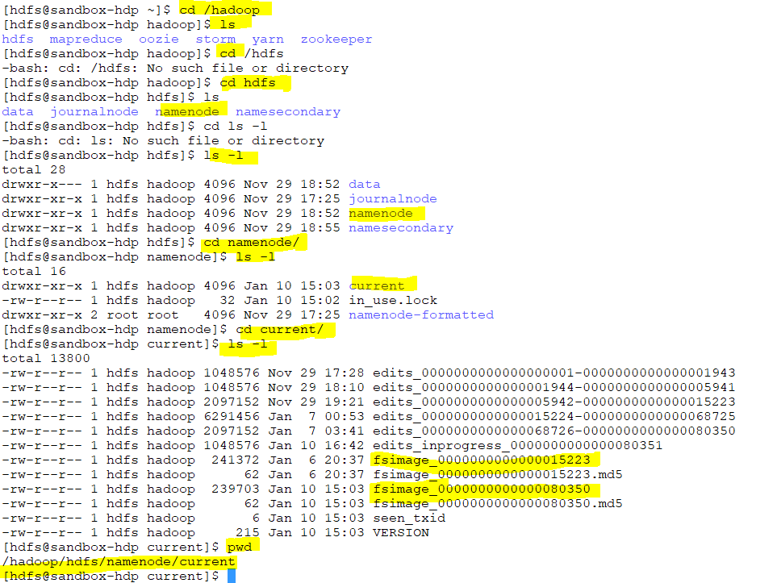

Slide 68
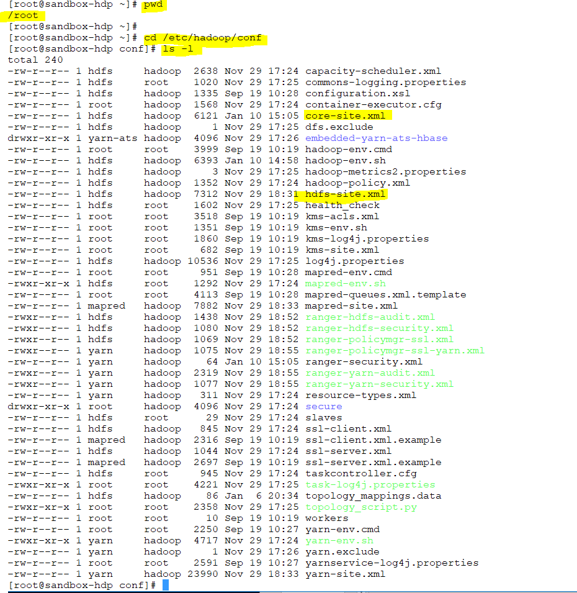

Slide 69
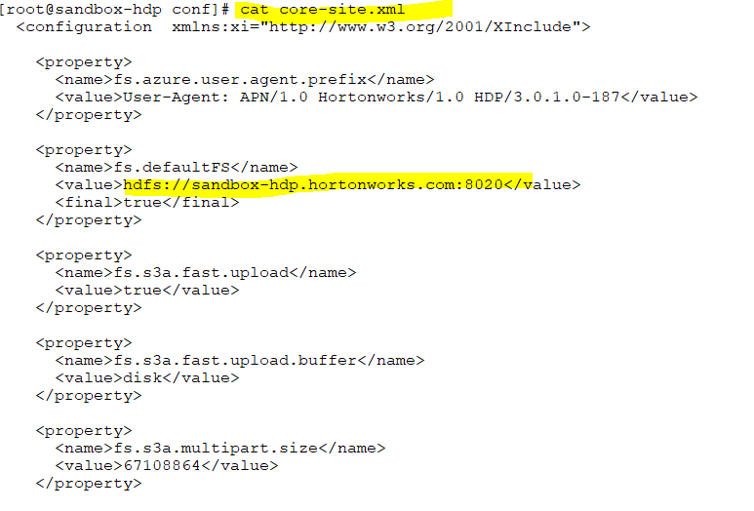
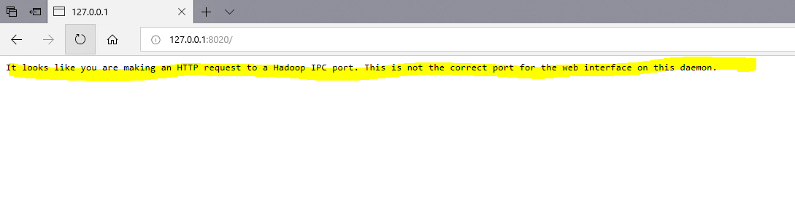
Notes:
It does not allow you.
These are the property of cluster or namenode

Slide 70
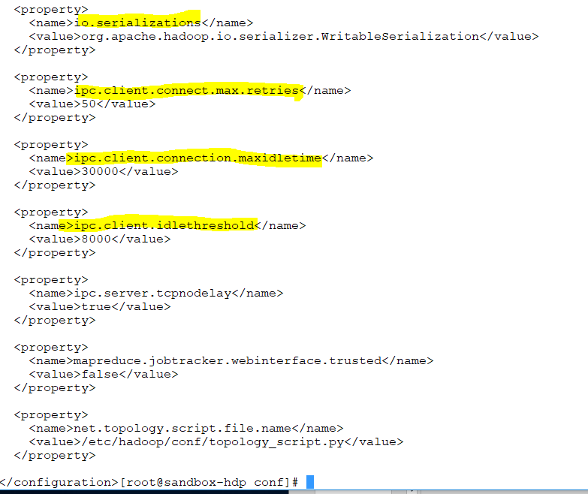

Slide 71
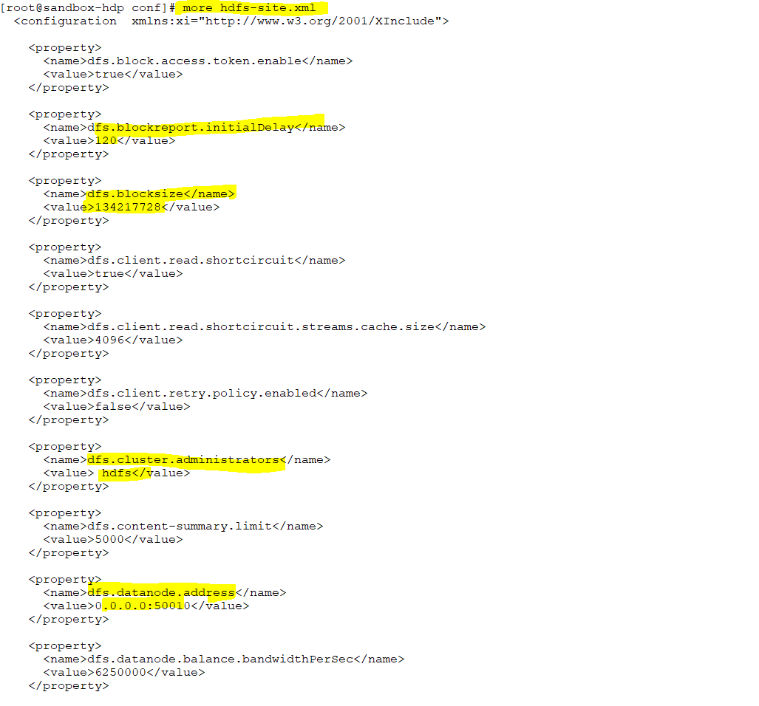

Slide 72
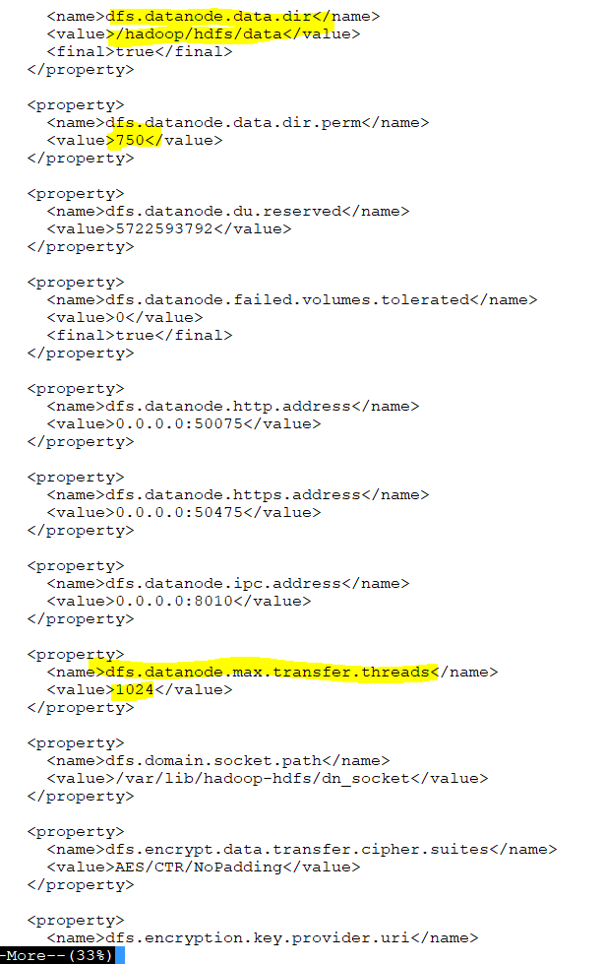
Notes:
/hadoop/hdfs/data
This is where all data is stored
750 permission

Slide 73
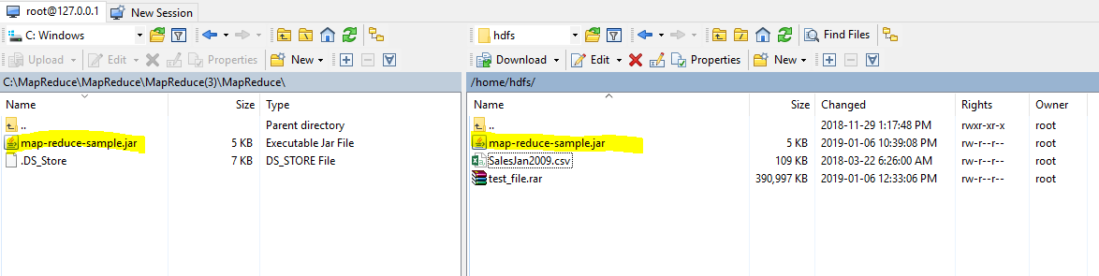
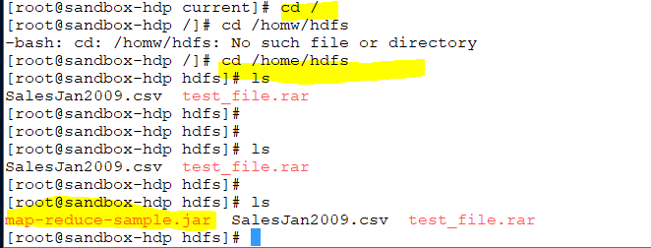

Slide 74
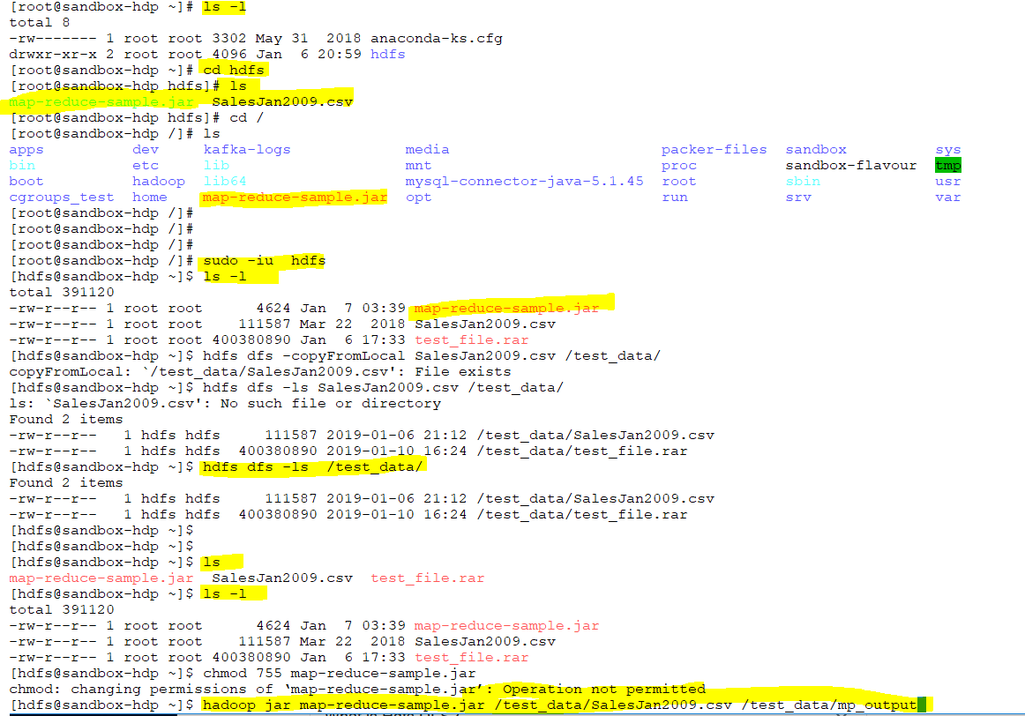
Notes:
We run it by using Hadoop command

Slide 75
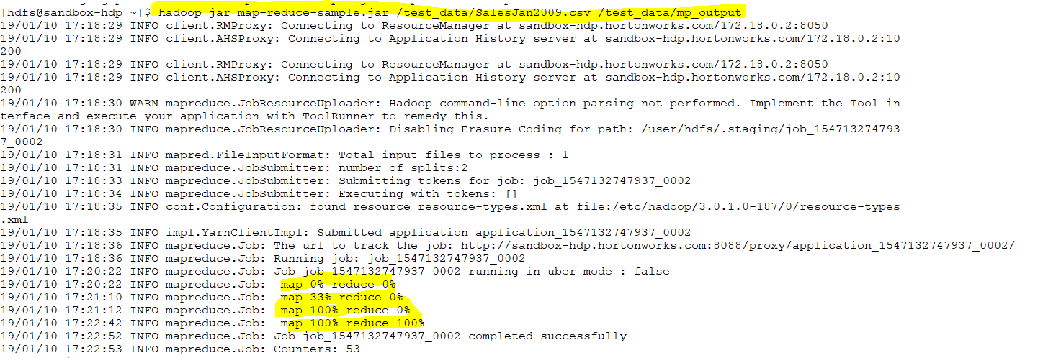

Slide 76
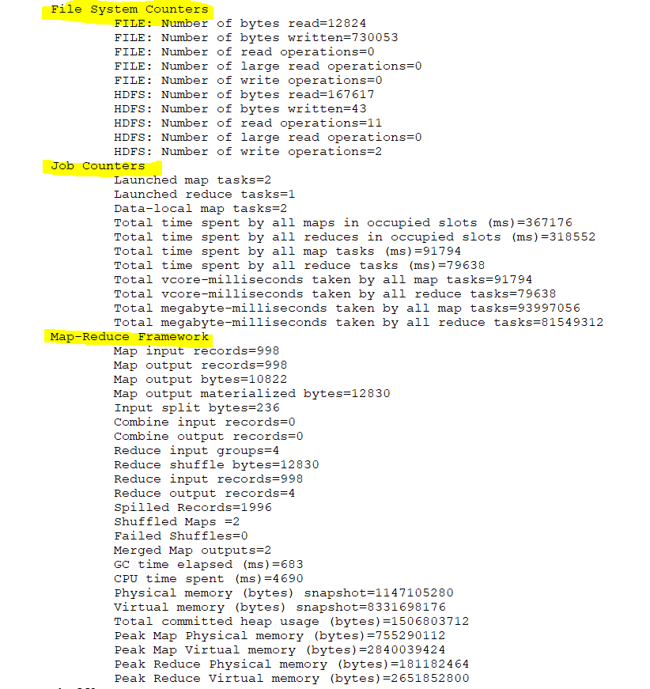
Notes:
[hdfs@sandbox-hdp ~]$ hadoop jar map-reduce-sample.jar /test_data/SalesJan2009.csv /test_data/mp_output

Slide 77
